Slide 1


Men are From Mars
Women are from Venus
John Gray Theories

Slide 2
1. Differences
It is important to recognize and remember that men and women have reciprocally different natures.
We need to appreciate these differences
We need to stop expecting each other to act and feel the way we do.

Slide 3
2. Values
Men like to offer solutions directly to women, when a problem arises, while women, offer unsolicited advice.
When men do this, it invalidates the women’s feelings, and men do not like to be “told what to do”, especially if they didn’t ask for advice.

Slide 4

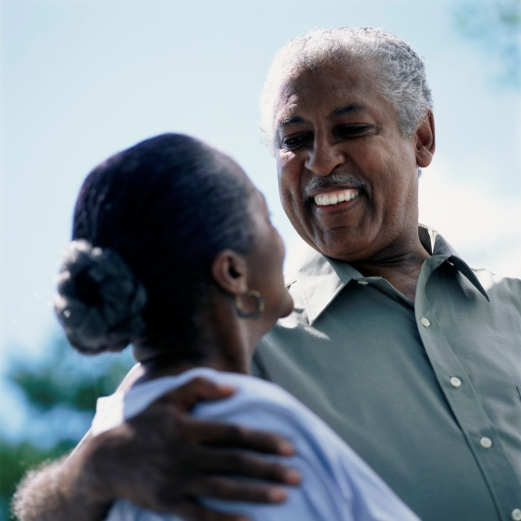
3. Stress
Men tend to pull away and silently think about what’s bothering them, Going into their “cave”
Women feel an instinctive need to talk about what’s bothering them.

Slide 5

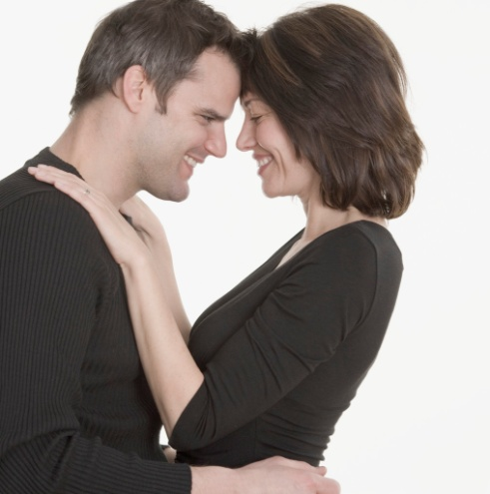
4. Motivation
Men feel motivated when they feel needed
Women are motivated when they feel cherished.

Slide 6
5. Languages
Men express things more literally
Women express things more about feelings

Slide 7



6. Intimacy
A man gets close, but then inevitably needs to pull away
Women need to understand this, and understand that when he retreats, he will swing back like a rubber band

Slide 8

7. Loving Attitude
Women are more like a wave and men need to learn to interpret how to be supportive.
Men need to learn how to interpret the sudden shifts of feelings
Men learn they are needed most when the wave “crashes”.

Slide 9

8. Love
Men and women usually give the kind of love they need and not what the opposite sex needs.
Men primarily need Trust, Acceptance, and Appreciation.
Women primarily need caring, understanding, and respect.

Slide 10

9. Argument
Men like to act as if they are always right, which may invalidate a woman’s feelings
Women sometimes unknowingly send messages of disapproval instead of disagreement, inciting a man’s defenses

Slide 11

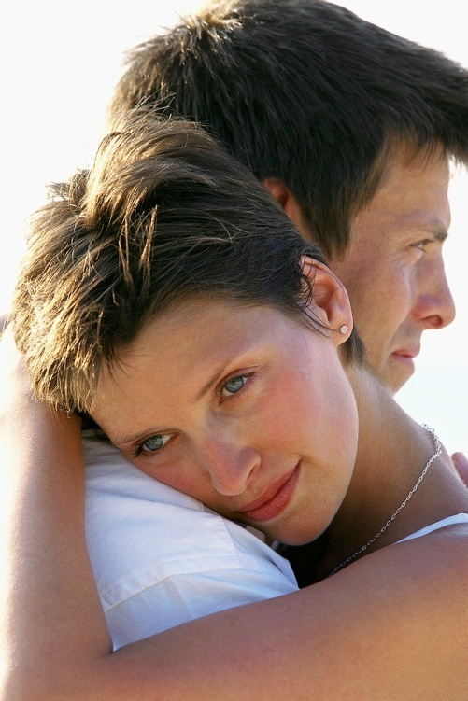
10. Score
Men think that one Big gift or
sacrifice, balances many little
signs of affection.
  Ex. $200 gift = 20 acts of love or service.
Women put equal values on each loving act.
  Ex. $200 gift = 1 act of love or service.

Slide 12

11. Communication
It is important to communicate during difficult times.
Sharing feelings instead of hiding them
The Love Letter Technique

Slide 13

12. Support
Men enjoy doing things that are appreciate and have a hard time doing things that are demanded.
Women need to ask for help without demands.

Slide 14

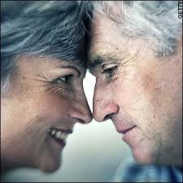
13. Keeping the Love Alive
Unresolved negative feelings can damage a relationship and need to be worked through.
Love changes over time – becomes stronger when you stick together through the ups and downs of life.

