Slide 1
Sociology origin, Definition & Schools of Thought
HSP 3U/C

Slide 2
Origins
Modern sociology came largely as a response to changing conditions in Europe during the Industrial Revolution
The Industrial Revolution brought about social, economic, and cultural changes
Was of significant benefit to the working class, significantly increasing their wealth; worse for the working class, who saw their jobs being done by machines
Many who had jobs were working long hours for low wages – Karl Marx considered this worse then slavery

Slide 3
Origins, continued
Child labour increased, as they could be paid even less than adults
Working conditions were horrible
People moved to urban areas to find work
Cities became overcrowded, living conditions worsened, crime rate rose.
As a response, many scholars began to write about and document the social problems they saw
Beginning of theories about social inequality

Slide 4
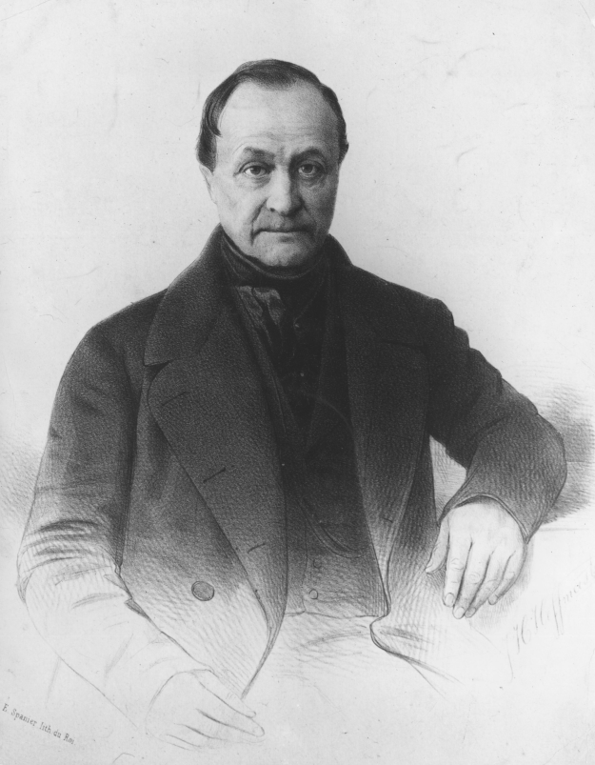
August Comte (1798-1857)
First to use the term sociology
Believed that society is constantly changing and observed that individuals and groups struggle to adapt to these changes.
Introduced the notion of positivism
Strict application of the scientific
method.
Data must be testable and measurable.

Slide 5
What is Sociology?
The study of people in groups.
Sociologists study group dynamics, interactions and social institutions and how they affect our lives.
They investigate social problems and developing issues such as:
Gender roles
Family structure
Social classes
Criminal behaviour
Social institutions
Ethnicity
Sexuality
Etc.

Slide 6
Examples of what Sociologists look at:
Nicholas Christakis: The Sociological Science Behind Social Networks and Social Influence (YouTube video: 1st 35 mins only)
Articles (see handout):
Sociology and Social Media (Jonathon Cohn 2012)
Beauty Around the World – A Sociological look at Beauty (2012)
Social Issues Mind Map assignment (see handout)

Slide 7
What is Sociology?
A sociologist is interested in the cultural expressions of a society – these are the shared symbols and learned behaviours that everyone in a society recognizes and understands.

Slide 8
Values, Norms, and Roles
A society helps the people within it to demonstrate learned behaviour
Values are shared ideas within a society about standards that are considered acceptable
For example, in Canada, free speech is a value
Norms are expectations about how to behave in a particular situation
For example, when you go to a concert, you are expected to yell and cheer and sing along, but the same behaviour in the classroom is unacceptable
Roles contain sets of expectations of others because of their particular social position.
For example, you would expect a police officer to stop to help you if you were at the side of the road fixing a flat tire, but you do not expect the same of the average citizen

Slide 9
Sociological Schools of Thought
Structural Functionalism
Conflict Theory
Feminist Sociology
Symbolic Interactionism

Slide 10
Structural Functionalism
States that a society is stable when social institutions (family, religion, politics, schools) meet the needs of its citizens.
These institutions, or structures of a society are interdependent and work together to meet the needs of individuals
Places emphasis on the power of social institutions to create happiness and harmony among its members. Optimistic that society can meet people’s needs.
Does not account for destructive forces in a society – structural functionalists tend to overlook important issues such as poverty and racism, which have their roots in the structure of society.

Slide 11
Conflict Theory
Studies competition between different groups for power
Is a result of those who have economic and political power (the bourgeoisie) and those who do not (the proletariat)
Those who have power seek to keep it away from those who do not; those who do not seek to acquire it.
Belief that social institutions, as they are controlled by the bourgeoisie, are designed to perpetuate the alienation of the poor.
Can also be applied to gender and racial issues.

Slide 12
Feminist Sociology
Studies how men control women’s lives – what jobs they can have, their finances, and their bodies
Examines the nature of the marginalization of women – their relative powerlessness and unequal membership in society
Examines the symbols, values, and norms of society
Suggests that class for men is based on their relationship to their economic role, while women’s class is determined through their sexual connection to men

Slide 13
Symbolic Interactionism
Studies human interaction at the micro level – emphasizes the individual living within a larger society.
Believes that social values are formed by individual interpretation
An individual creates a sense of self by considering the reaction of others.
Social life depends on our ability to imagine ourselves in our social roles
Does not focus on social systems, but on the way that individuals, through their interpretations of social situations and behavioural negotiation with others, give meaning to social interactions.

Slide 14
Sociological Theorists
Jigsaw Activity: (see handout)
Emile Durkheim
Talcott Parsons
Karl Marx
C. Wright Mills
Dorothy Smith
Max Weber
Charles Cooley
George Herbert Mead

